Slide 1
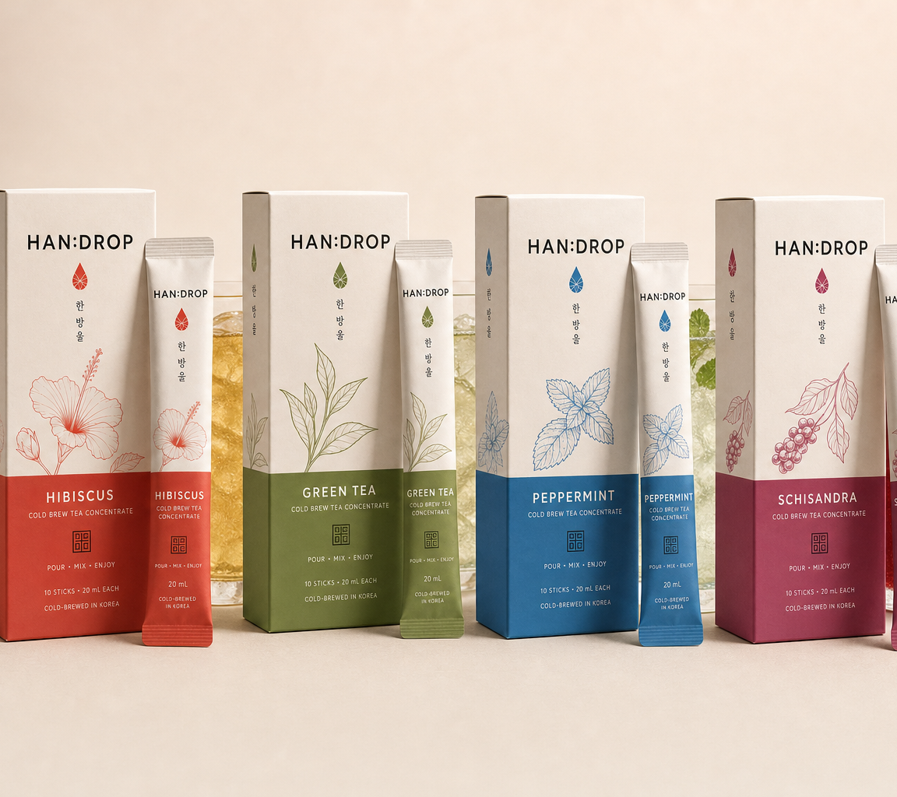
HAN:DROP
Korean tea,
made effortless.
A distributor-ready concept built around single-serve convenience, Korean identity and efficient ambient logistics.
PRODUCT & PARTNERSHIP PRESENTATION
PRELIMINARY DISTRIBUTOR MATERIAL - PROPRIETARY | © 2026 WOK FOODS (THAILAND) CO., LTD. All rights reserved.

Slide 2
CONSUMER VALUE
One stick turns water into a finished tea serve
20 mL
200 mL
≈ 220 mL
+
=
SINGLE-SERVE CONCENTRATE
WATER
READY-TO-DRINK TEA
No brewing time
Hot, cold or sparkling
Portable and consistent
A simple demonstration makes the product easy to explain at shelf, online or in a buyer meeting.
Preparation ratio and format based on the supplier technical data sheet.
PRELIMINARY DISTRIBUTOR PRESENTATION • JULY 2026 | 2
PRELIMINARY DISTRIBUTOR MATERIAL - PROPRIETARY | © 2026 WOK FOODS (THAILAND) CO., LTD. All rights reserved.

Slide 3
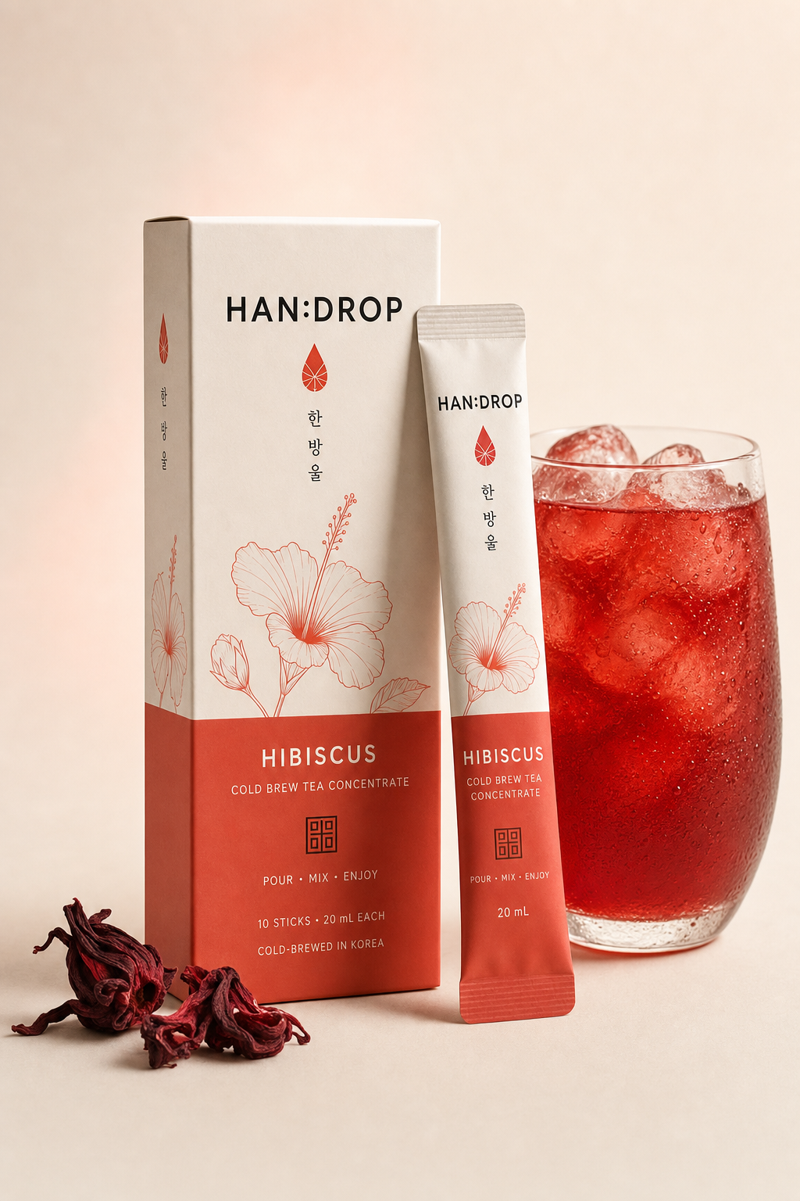

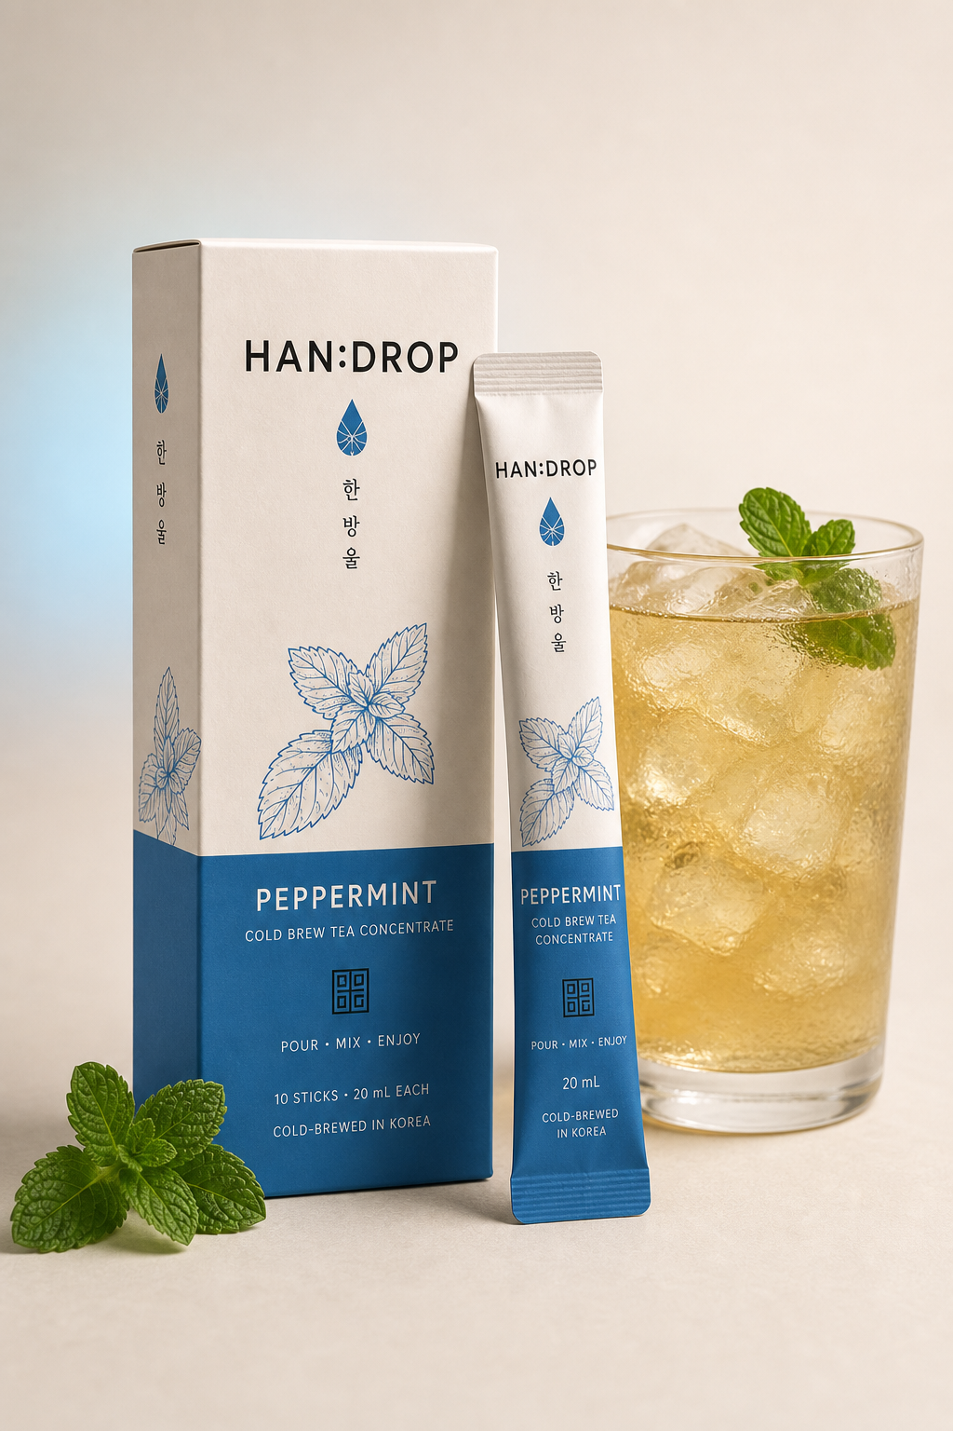
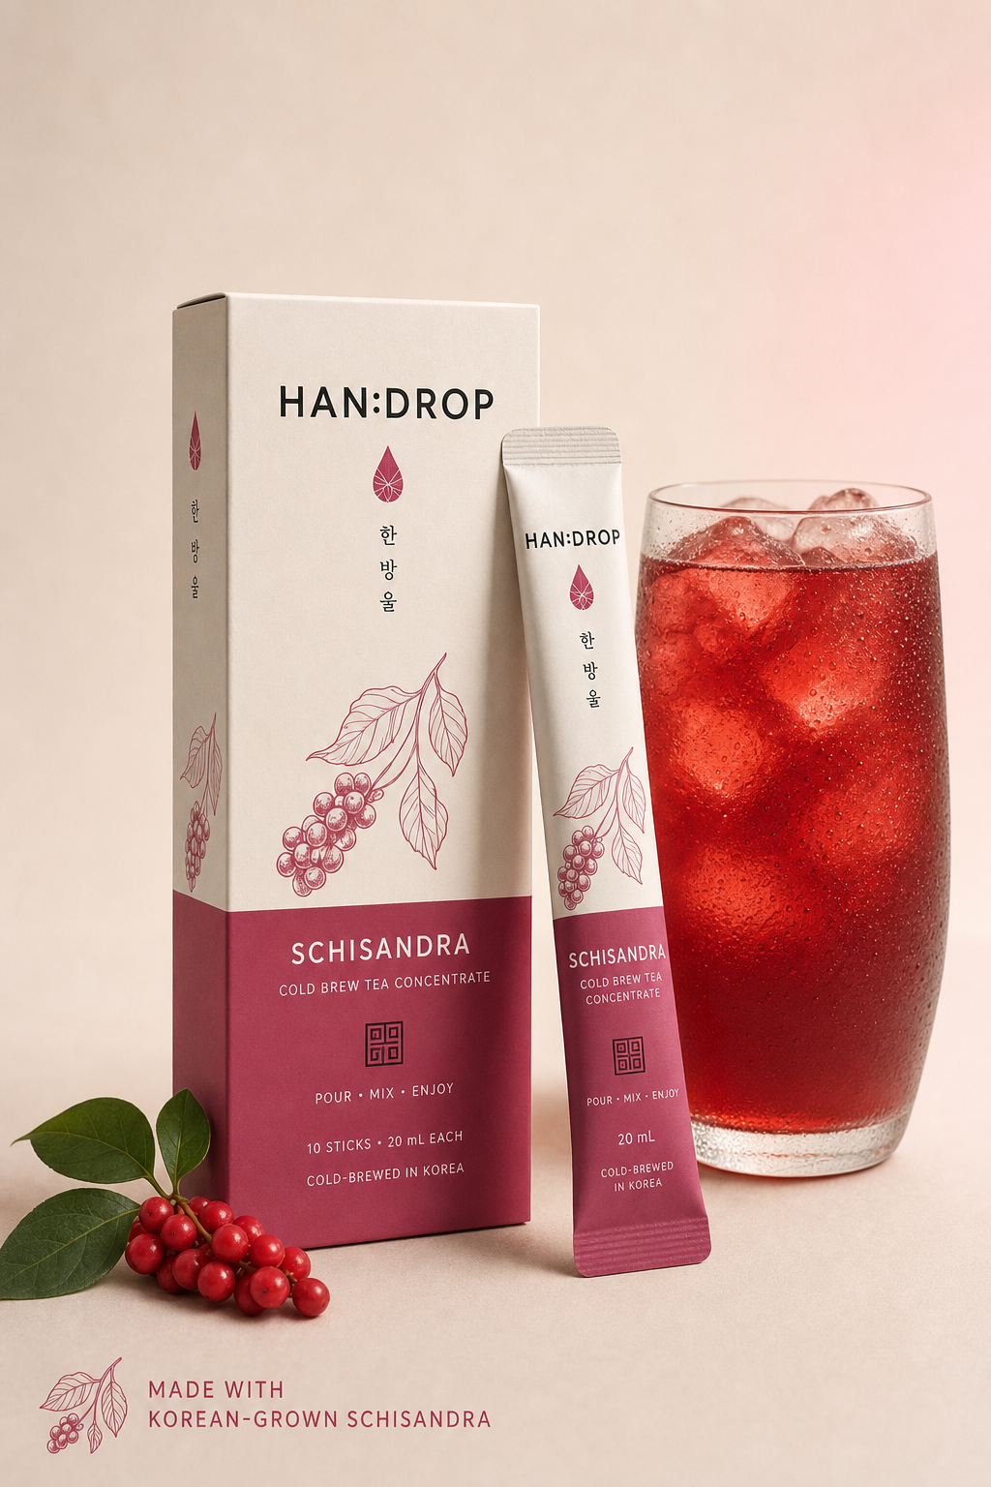
LAUNCH COLLECTION
Four flavours create four reasons to buy
HIBISCUS
GREEN TEA
PEPPERMINT
SCHISANDRA
Bright refreshment
Everyday clarity
Cooling reset
Korean signature
Familiar flavours invite trial. Schisandra provides a distinctive Korean hero product.
PRELIMINARY DISTRIBUTOR PRESENTATION • JULY 2026 | 3
PRELIMINARY DISTRIBUTOR MATERIAL - PROPRIETARY | © 2026 WOK FOODS (THAILAND) CO., LTD. All rights reserved.

Slide 4
USAGE OCCASIONS
Convenience expands when and where consumers choose tea
10
WORK
Fast desk-side preparation
TRAVEL
Light, portable format
individually packed serves
HOME
Hot, cold or sparkling
FOODSERVICE
Repeatable serving ratio
GIFTING
Premium Korean presentation
One format supports multiple moments without changing the core product.
PRELIMINARY DISTRIBUTOR PRESENTATION • JULY 2026 | 4
PRELIMINARY DISTRIBUTOR MATERIAL - PROPRIETARY | © 2026 WOK FOODS (THAILAND) CO., LTD. All rights reserved.

Slide 5
RETAIL VALUE
Retailers gain a product that is easy to understand
01
The benefit is visible
Tear, pour and mix can be demonstrated in seconds.
02
The range is navigable
Distinct colours and botanical cues separate each flavour.
03
The shelf story is premium
Contemporary Korean design creates recognition without looking medicinal.
A short explanation can convert curiosity into trial.
PRELIMINARY DISTRIBUTOR PRESENTATION • JULY 2026 | 5
PRELIMINARY DISTRIBUTOR MATERIAL - PROPRIETARY | © 2026 WOK FOODS (THAILAND) CO., LTD. All rights reserved.

Slide 6
DISTRIBUTOR VALUE
The format is designed for efficient ambient distribution
24 mo
20
100
2,000
DECLARED SHELF LIFE
RETAIL BOXES PER CASE
CASES PER QUOTED PALLET
RETAIL BOXES PER PALLET
Ambient / cool storage
Compact 200 mL retail box
Mixed-product sample pallet
Long shelf life can support broader territory coverage, while the mixed-pallet option allows a focused launch across four SKUs.
All logistics figures are supplier-reported or calculated from supplier carton data; pallet footprint and tare remain to be confirmed.
PRELIMINARY DISTRIBUTOR PRESENTATION • JULY 2026 | 6
PRELIMINARY DISTRIBUTOR MATERIAL - PROPRIETARY | © 2026 WOK FOODS (THAILAND) CO., LTD. All rights reserved.

Slide 7
CHANNEL EXPANSION
One format can support several routes to market
01
02
03
04
05
SPECIALTY RETAIL
E-COMMERCE
HORECA
OFFICE & TRAVEL
GIFTING
Premium shelf story
Light, visual, demonstrable
Consistent preparation ratio
Portable single serves
Korean design appeal
Distributors can start with the channel that best fits their market, then broaden without changing the product architecture.
PRELIMINARY DISTRIBUTOR PRESENTATION • JULY 2026 | 7
PRELIMINARY DISTRIBUTOR MATERIAL - PROPRIETARY | © 2026 WOK FOODS (THAILAND) CO., LTD. All rights reserved.

Slide 8
BRAND DIFFERENTIATION
Korean identity gives the range a clear point of difference
HAN:DROP
Readable globally
English-led communication with a controlled Korean signature.
한 방울
Recognisably Korean
Hangul, restraint and colour create authenticity without clichés.
KOREA, BREWED INTO A DROP.
Premium, not medicinal
Botanical illustration and clean hierarchy keep the focus on taste.
Built as a family
One visual system can extend to new flavours and formats.
PRELIMINARY DISTRIBUTOR PRESENTATION • JULY 2026 | 8
PRELIMINARY DISTRIBUTOR MATERIAL - PROPRIETARY | © 2026 WOK FOODS (THAILAND) CO., LTD. All rights reserved.

Slide 9
MARKET ADAPTATION
The brand stays consistent while compliance stays local
GLOBAL FRONT
LOCAL BACK PANEL
Locked brand identity
Flavour navigation
Preparation cue
Made-in-Korea signal
Legal product name
Ingredients and nutrition
Importer details
Language and recycling
One coherent global brand — adapted through an approved local information module.
Final ingredients, nutrition declarations and private-label specifications remain pending manufacturer confirmation.
PRELIMINARY DISTRIBUTOR PRESENTATION • JULY 2026 | 9
PRELIMINARY DISTRIBUTOR MATERIAL - PROPRIETARY | © 2026 WOK FOODS (THAILAND) CO., LTD. All rights reserved.

Slide 10
A FOCUSED PATH TO MARKET
Start focused.
Learn quickly.
Scale with confidence.
HAN:DROP
A modern Korean tea ritual
with practical distribution economics.
1
Confirm final specification
Ingredients, nutrition, private-label MOQ and pallet data.
2
Launch one mixed pallet
Use four flavours to learn which occasion and channel converts.
3
Scale the winners
Expand volume, territories and channels using one brand platform.
Source basis: supplier brochure, tea TDS dated 10 July 2026 and supplier price list dated 7 July 2026. Commercial terms supplied separately.
PRELIMINARY DISTRIBUTOR MATERIAL - PROPRIETARY | © 2026 WOK FOODS (THAILAND) CO., LTD. All rights reserved.

